Slide 1

APPLICATION LAYER
Prepared By:
Nitin Narang

Slide 2

Network devices are components used to connect computers or other electronic devices together so that they can share files or resources like printers or fax machines
Network devices are components used to connect computers or other
electronic devices together so that they can share files or resources like printers or fax machines.

Slide 3

HUB
SWITCH GATEWAY BRIDGE ROUTER REPEATER

Slide 4

A hub is a common connection point
for devices in a network. Hubs are commonly used to connect segments of a LAN.
A hub contains multiple ports. When a packet arrives at one port, it is copied to the other ports so that all segments of the LAN can see all packets.

Slide 5
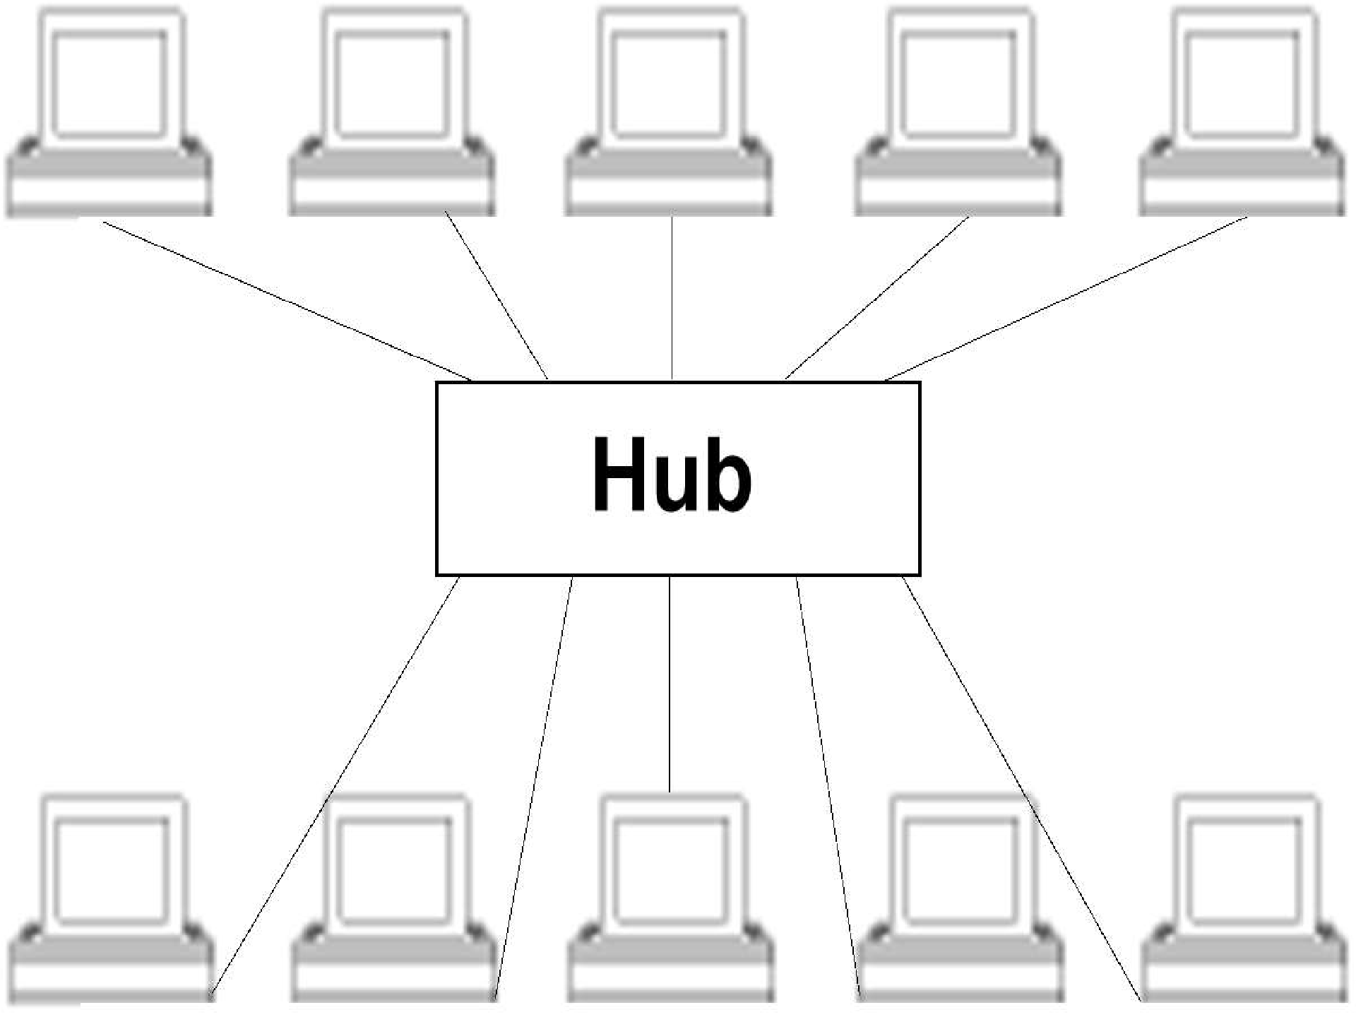

Slide 6
Types of Hub
a.Active Hub:- These are the hubs which have their own power supply and can clean, boost and relay the signal along with the network. It serves both as a repeater as well as wiring centre.
b. Passive Hub :- These are the hubs which connect wiring from nodes and power supply from active hub. These hubs relay signals onto the network without cleaning and boosting them.
c. Intelligent Hub :- It work like active hubs and include remote management capabilities. They also provide flexible data rates to network devices. It also enables an administrator to monitor the traffic passing through the hub and to configure each port in the hub.

Slide 7
SWITCH
A network switch (also called switching hub, bridging hub, officially MAC bridge) is a computer networking device that connects devices together on a computer network by using packet switching to receive, process, and forward data to the destination device.

Slide 8
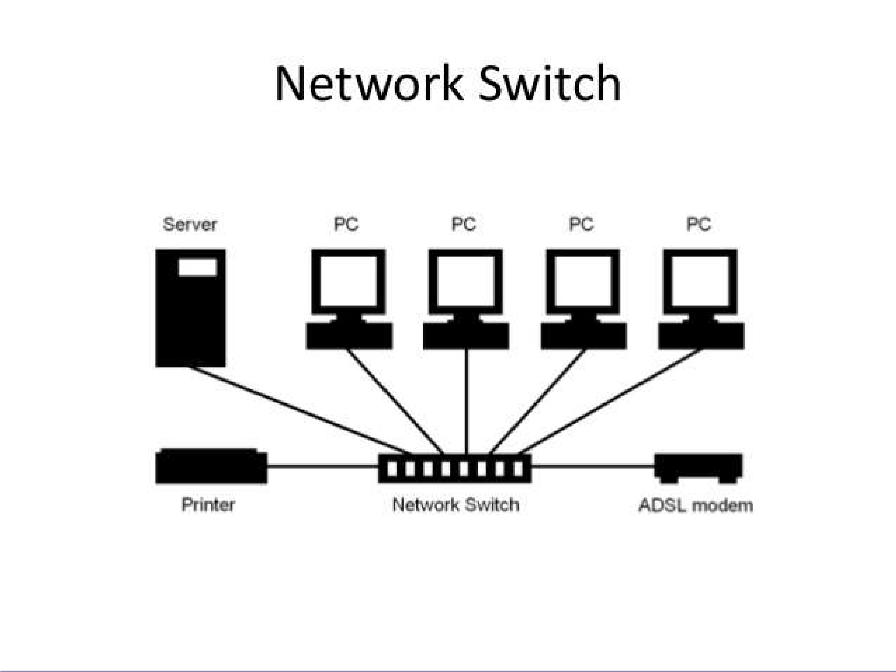

Slide 9

A network gateway is an internetworking system capable of joining together two networks that use different base protocols. A network gateway can be implemented completely in software, completely in hardware, or as a combination of both. Depending on the types of protocols they support, network gateways can operate at any level of the OSI model.

Slide 10
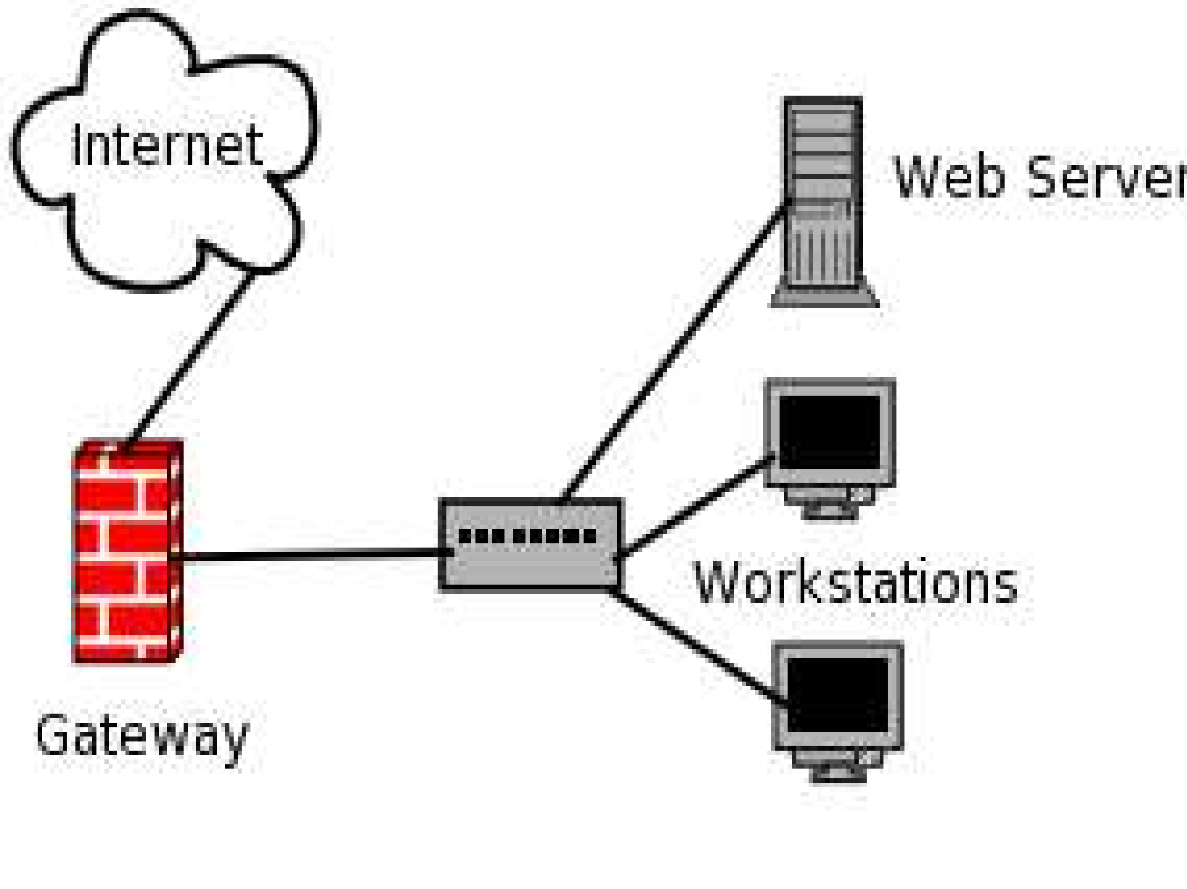

Slide 11

A network bridge is a computer networking device that creates a single aggregate network from multiple communication networks or network segments. This function is called network bridging.

Slide 12
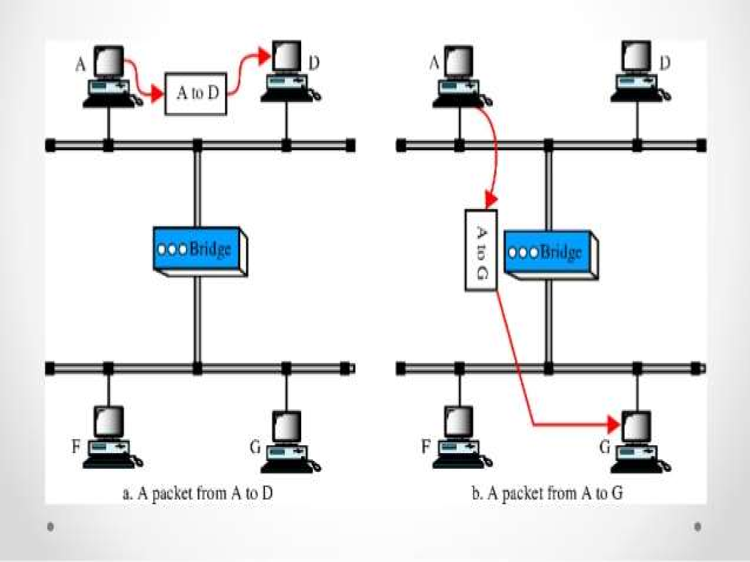

Slide 13
Types of Bridges
a. Transparent Bridges:- These are the bridge in which the stations are completely unaware of the bridge’s existence i.e. whether or not a bridge is added or deleted from the network, reconfiguration of the stations is unnecessary. These bridges make use of two processes i.e. bridge forwarding and bridge learning.
b. Source Routing Bridges:- In these bridges, routing operation is performed by source station and the frame specifies which route to follow. The hot can discover frame by sending a special frame

Slide 14

A router is a networking device that forwards data packets between computernetworks.
Routers perform the traffic directing functions on the Internet. A data packet is typically forwarded from one router to another router through the networks that constitute the internetwork until it reaches its destination node.

Slide 15
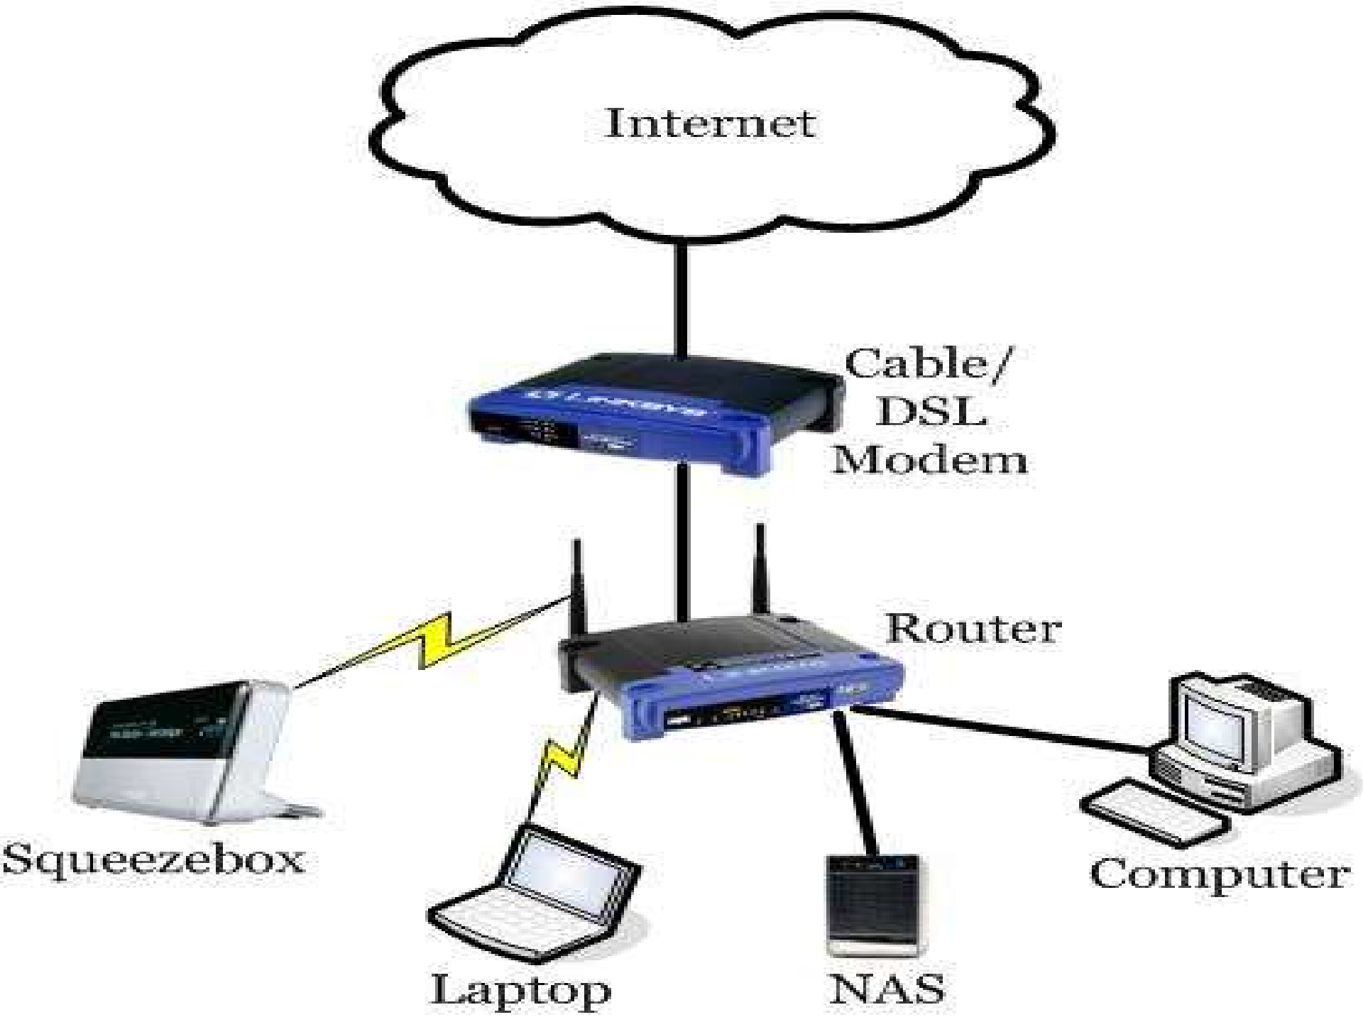

Slide 16

A network device used to regenerate or replicate a signal. Repeaters are used in transmission systems to regenerate analog or digital signals distorted by transmission loss.

Slide 17
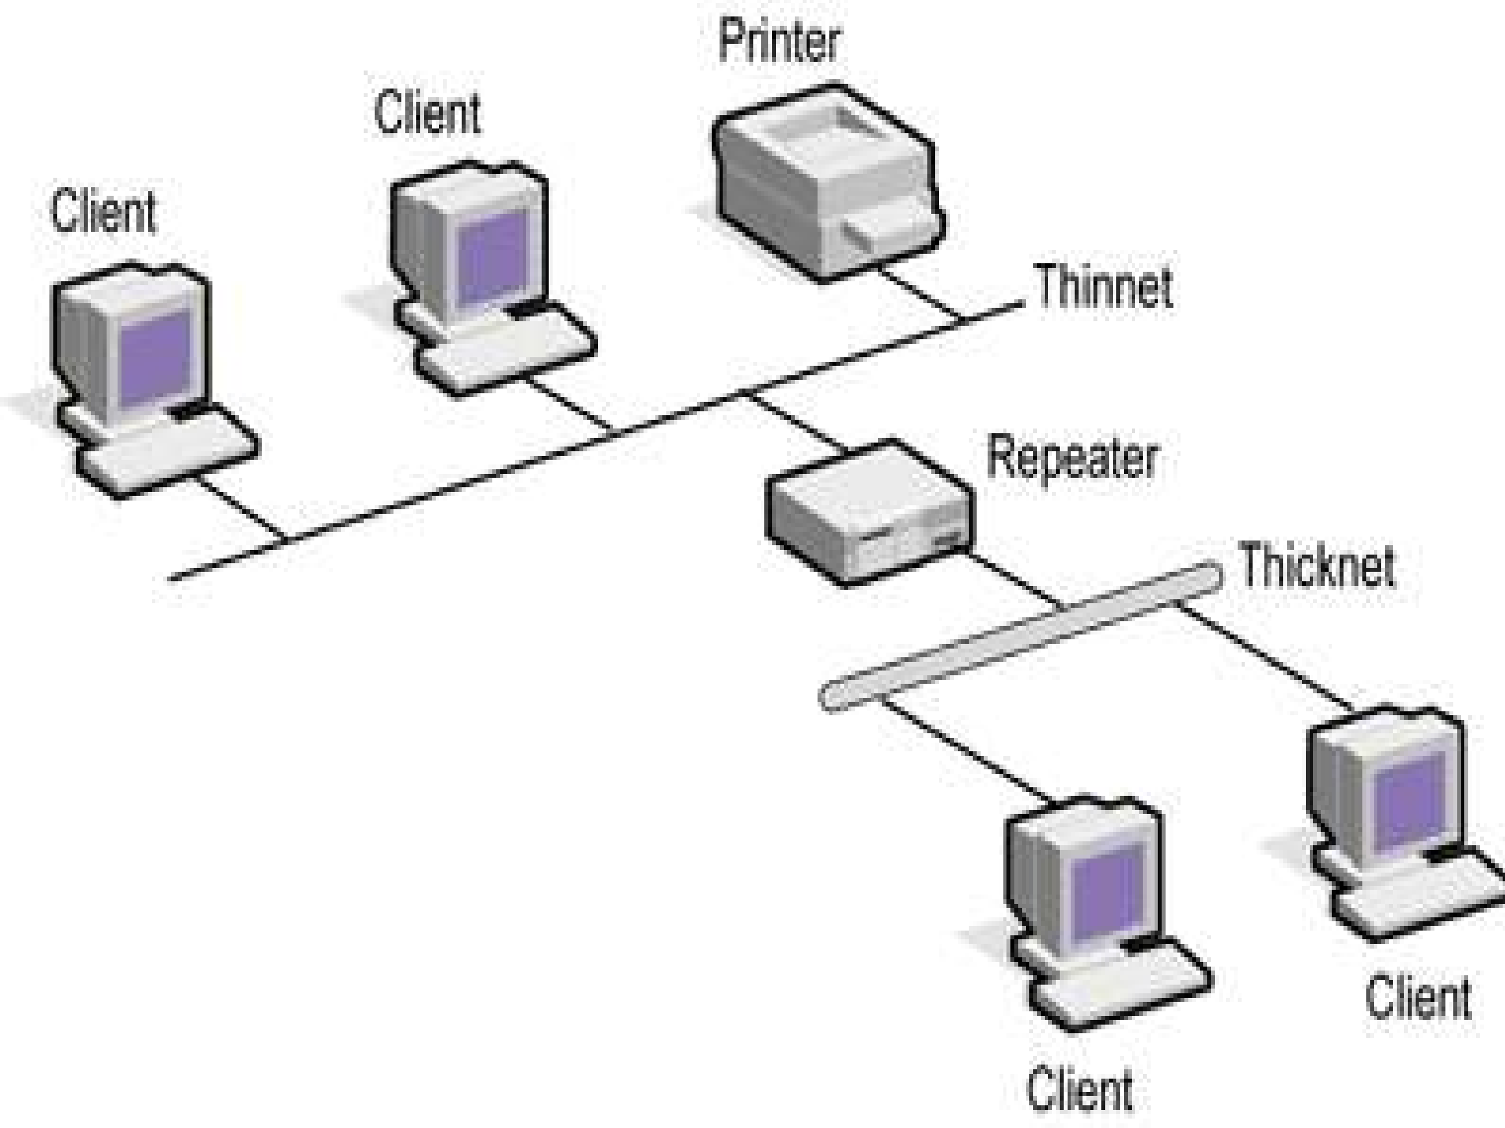

Slide 18
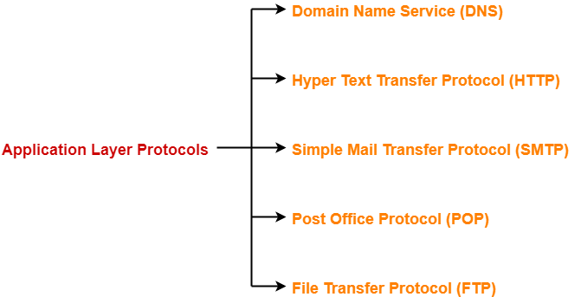
Application Layer Protocols-

Slide 19

DNS in Networking-
DNS is short for Domain Name Service or Domain Name System.
It is an application layer protocol.
Purpose-
DNS is a host name to IP Address translation service.
It converts the names we type in our web browser address bar to the IP Address of web servers hosting those sites.

Slide 20
Need-
The need for Domain Name Service arises due to the following reasons-
Point-01:
IP Addresses are not static and may change dynamically.
So, a mapping is required which maps the domain names to the IP Addresses of their web servers.
Point-02:
IP Addresses are a complex series of numbers.
So, it is difficult to remember IP Addresses directly while it is easy to remember names.

Slide 21
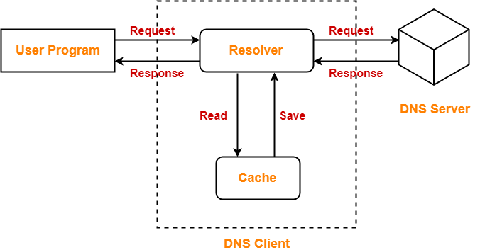
DNS Resolution-
DNS Resolution is a process of resolving a domain name onto an IP Address.
The following diagram illustrates the process of DNS resolution-

Slide 22
The steps involved in DNS Resolution are-
Step-01:
A user program sends a name query to a library procedure called the resolver.
Step-02:
Resolver looks up the local domain name cache for a match.
If a match is found, it sends the corresponding IP Address back.
If no match is found, it sends a query to the local DNS server.
Step-03:
DNS server looks up the name.
If a match is found, it returns the corresponding IP Address to the resolver.
If no match is found, the local DNS server sends a query to a higher level DNS server.
This process is continued until a result is returned.
Step-04:
After receiving a response, the DNS client returns the resolution result to the application.

Slide 23
DNS uses UDP at the transport layer due to the following reasons-
Point-01:
UDP is much faster than TCP.
TCP is slow as it uses Three-way handshake to start the data transfer.
Point-02:
DNS requests are very small.
So, they fits well within UDP segments.
Point-03:
Although UDP is not reliable but reliability can be added on application layer.
Reliability can be added by using timeouts and resend at the application layer.
Thus, in the end both speed and protection are achieved.

Slide 24
DNS is a connection less protocol.
DNS uses UDP at the transport layer for replying to the DNS queries of clients.
Therefore, it is a connection less protocol.
DNS is a stateless protocol.
This is because- DNS server accepts the requests, process them, resolves the query and forget about them.
It does not make any assumption how long this will be.
Mapping an IP Address onto a domain name is referred to as Inverse domain
It is important to note-
DNS can translate a domain name onto an IP Address.
Also, it can translate an IP Address onto a domain name.

Slide 25
Mapping an IP Address onto a domain name is referred to as Inverse domain
Converting a domain name onto an IP Address is an extra overhead.This overhead is called as DNS Overhead.
It causes an unnecessary delay in serving the request.
So, there is more delay for the first time
To reduce the delay next time, IP Addresses are stored in the computer using log.
This avoids the DNS overhead next time and takes less time in serving the request.
When it gets expired, the request is again served through DNS.

Slide 26
File Transfer Protocol-
FTP is short for File Transfer Protocol.
It is an application layer protocol.
Purpose-
It is used for exchanging files over the internet.
It enables the users to upload and download the files from the internet.

Slide 27
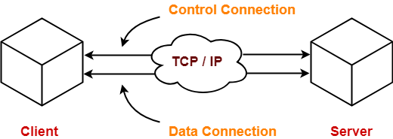
Working-
FTP establishes two TCP connections between the client and the server.
One connection is used for transferring data.
Other connection is used for transferring control information.

Slide 28
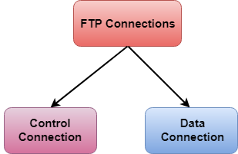
There are two types of connections in FTP:
Control Connection: The control connection uses very simple rules for communication. Through control connection, we can transfer a line of command or line of response at a time. The control connection is made between the control processes. The control connection remains connected during the entire interactive FTP session.
Data Connection: The Data Connection uses very complex rules as data types may vary. The data connection is made between data transfer processes. The data connection opens when a command comes for transferring the files and closes when the file is transferred.

Slide 29
Characteristics of FTP-
FTP uses TCP at the transport layer.
FTP uses persistent TCP connections for control connection.
FTP uses non-persistent connections for data connection.
FTP is a connection oriented protocol.
FTP is an out-of-band protocol as data and control information flow over different connections.

Slide 30
Emails can’t be sent using FTP.
This is because-FTP requires the connection establishment between the client and server before transferring the files.
So, both have to be online at the same time.
That is why, emails are not sent using FTP.
FTP can transfer one file at a time.
FTP is used for transferring one file at a time in either direction between the client and the server.

Slide 31
Hyper Text Transfer Protocol-
HTTP is short for Hyper Text Transfer Protocol.
It is an application layer protocol.
Purpose-
It is mainly used for the retrieval of data from websites throughout the internet.
It works on the top of TCP/IP suite of protocols.

Slide 32
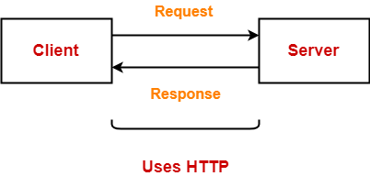
Working-
HTTP uses a client-server model where-
Web browser is the client.
Client communicates with the web server hosting the website.
Whenever a client requests some information (say clicks on a hyperlink) to the website server.
The browser sends a request message to the HTTP server for the requested objects.
Then-
HTTP opens a connection between the client and server through TCP.
HTTP sends a request to the server which collects the requested data.
HTTP sends the response with the objects back to the client.
HTTP closes the connection.

Slide 33
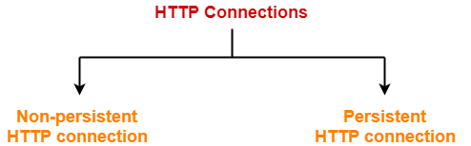
HTTP Connections-
HTTP connections can be of two types-
Non-persistent HTTP connection
Persistent HTTP connection

Slide 34
Non-persistent HTTP connection | Persistent HTTP connection
Non-persistent HTTP connection is one that is used for serving exactly one request and sending one response. | Persistent HTTP connection is one that can be used for serving multiple requests.
HTTP server closes the TCP connection automatically after sending a HTTP response. | HTTP server closes the TCP connection only when it is not used for a certain configurable amount of time.
A new separate TCP connection is used for each object. | A single TCP connection is used for sending multiple objects one after the other.
HTTP 1.0 supports non-persistent connections by default. | HTTP 1.1 supports persistent connections by default.
Example- Suppose a request has been made for a HTML page that contains 10 images (called objects). Then, With non-persistent connection, all the 11 objects (1 page + 10 images) will be sent one by one. For getting each object, a new separate connection will be opened and used. | Example- Suppose a request has been made for a HTML page that contains 10 images (called objects). Then, With persistent connection, all the 11 objects (1 page + 10 images) will be sent one after the other using a single TCP connection.

Slide 35
POP(Post Office Protocol)
POP is short for Post Office Protocol.
It is an application layer protocol.
Purpose-
It is a message access protocol.
It enables the clients to receive or download the emails from their remote mail server.
POP version 3 (POP3) is the most popularly used version.

Slide 36
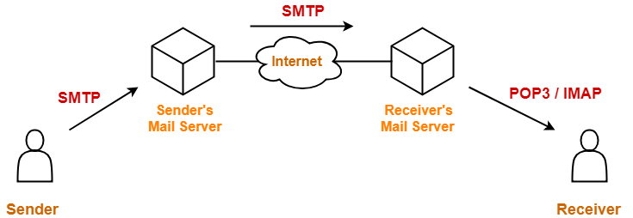
Working-
To retrieve a message from the mail server-
Client establishes a TCP connection .
Client identifies itself to the server.
Client issues a series of POP3 commands.

Slide 37
Characteristics of POP-
POP is a pull protocol.
POP uses TCP at the transport layer.
POP uses port number 110.
POP uses persistent TCP connections.
POP is a connection oriented protocol.
POP is an in-band protocol.
POP is a stateful protocol until the mail is downloaded as well as stateless across sessions.

Slide 38
Internet Message Access Protocol-
IMAP is short for Internet Message Access Protocol.
It is an application layer protocol.
It also enables the clients to receive or download the emails from their remote mail server.
Characteristics of IMAP-
IMAP is a pull protocol.
IMAP uses TCP at the transport layer.
IMAP uses port number 143.
IMAP uses persistent TCP connections.
IMAP is a connection oriented protocol.
IMAP is an in-band protocol.
IMAP is a stateful protocol.
IMAP distributes mail boxes across multiple servers.

Slide 39
POP Vs IMAP-
The following table lists the differences between POP and IMAP-
Post Office Protocol | Internet Message Access Protocol
POP allows you to read the mail only after downloading it. | IMAP allows you to check the mail content before downloading. So, with IMAP you can choose to download your messages or just delete them.
The email message is downloaded to the local computer and the copy at the server is deleted. | The email message is stored on the mail server itself.
The user can not organize mails in the mail box of the mail server. | The user can organize mails on the server.
Mails can only be accessed from a single device. | Mails can be accessed from multiple devices which is the biggest advantage.
In POP, the mail server and client’s mail account are not synced. So, changes made in the client’s mail account are not visible on the web mail inbox. Example- If you are using POP and marks a mail as read, it does not get marked as read in the web mail inbox because the mails are downloaded to the computer and so the changes won’t be visible on the server. | In IMAP, the mail server and the client’s mail account are synced. So, changes made in the client’s mail account are instantly visible on the web mail inbox. Example- If you are using IMAP and marks a mail as read, it gets marked as read in the web mail inbox too because the changes are taking place on the server.
POP is a stateful protocol until the mail is downloaded as well as stateless across sessions. | IMAP is a stateful protocol because the IMAP server has to maintain a folder hierarchy for each of its users.
POP is a better choice for those who hardly checks their mail on any other computer. | IMAP is a better choice for those who frequently check their mails on other computers.

Slide 40
Simple Mail Transfer Protocol-
SMTP is short for Simple Mail Transfer Protocol.
It is an application layer protocol.
It is used for sending the emails efficiently and reliably over the internet.
Working-
SMTP server is always on a listening mode.
Client initiates a TCP connection with the SMTP server.
SMTP server listens for a connection and initiates a connection on that port.
The connection is established.
Client informs the SMTP server that it would like to send a mail.
Assuming the server is OK, client sends the mail to its mail server.
Client’s mail server use DNS to get the IP Address of receiver’s mail server.
Then, SMTP transfers the mail from sender’s mail server to the receiver’s mail server.

Slide 41
While sending the mail, SMTP is used two times-
Between the sender and the sender’s mail server
Between the sender’s mail server and the receiver’s mail server

Slide 42
Characteristics of SMTP-
SMTP is a push protocol.
SMTP uses TCP at the transport layer.
SMTP uses port number 25.
SMTP uses persistent TCP connections, so it can send multiple emails at once.
SMTP is a connection oriented protocol.
SMTP is an in-band protocol.
SMTP is a stateless protocol.

Slide 43
Multipurpose Internet Mail Extensions(MIME):
The MIME defines five new message header
MIME-Version: It tells the use agent receiving the message that it is dealing with a MIME message, and which version of MIME it uses.
Content-Description: It tells what is there in the message, this header helps the recipient whether it is worth decoding and reading the message.
Content-Transfer Encoding: It tells how the body is wrapped for transmission through a network that may object to most characters other than letters, numbers and punctuation marks.
Content-Type: It specifies the nature of the message body. Seven types are defined in RFC 1521, each of which has one or more sub types. The type and sub type are separated by a slash. The sub type must be given explicitly in the header, no defaults are provided. Table shows the list of types and sub types.

Slide 44
